Slide 1
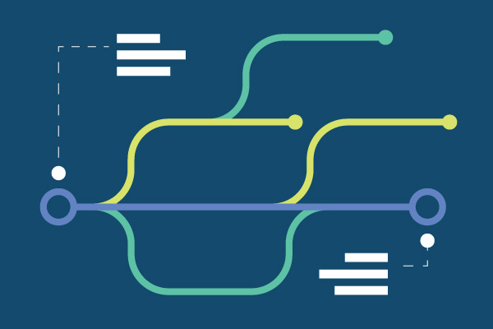
Git Advanced concepts

Slide 2
Learning Outcomes
Find bugs using git commands.
Tracking your code.
Will now more about git concepts.

Slide 3
prerequisite
Basic knowledge of git.
No other prior knowledge required.

Slide 4
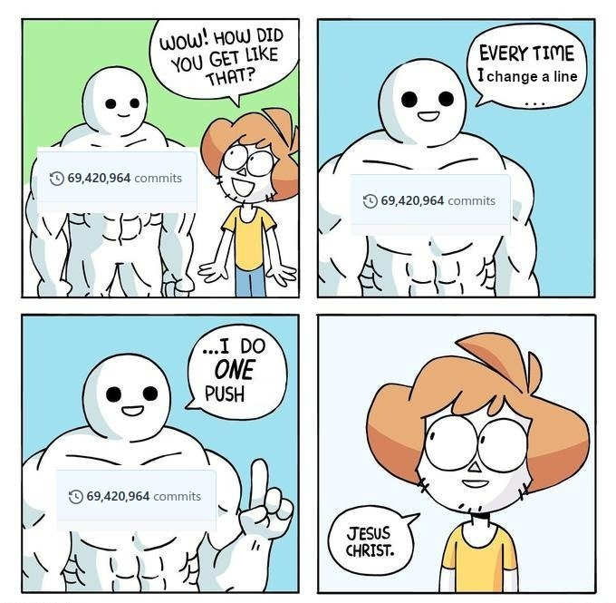
GIT STASH

Slide 5
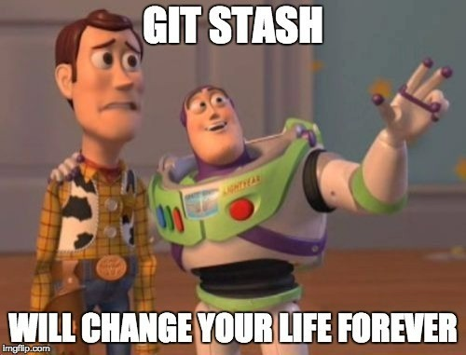
Git stash
Using git stash:
Save changes to branch A.
Run git stash.
Check out branch B.
Fix the bug in branch B.
Commit and (optionally) push to remote.
Check out branch A.
Run git stash pop to get your stashed changes back.

Slide 6
git bisect
git-bisect - Use binary search to find the commit that introduced a bug.
SYNOPSIS- git bisect <subcommand> <options>
bisect commands-
git bisect start
git bisect bad
git bisect good

Slide 7
Git reflog
Reference log (Reflog) is basically your safety net after running "scary" commands like git rebase. You'll be able to see not only the commits you made, but each of the actions that led you there. See this Atlassian article to learn more about how refs work.

Slide 8
Git diff
Commands:
git diff: changes made in all unstaged files.
git diff <filename>:changes made in that specific file.
git diff --staged <filename>:changes made in staged file.
git diff <branch1>..<branch2>:comparing tips of two different branches.
git diff <branch1>..<branch2> <filename>:comparing tips of two different branches for a specific file.

Slide 9
Git switch
git-switch - Switch branches.
<branch-name>
-c <new-name>
<branch-name> --discard-changes

Slide 10
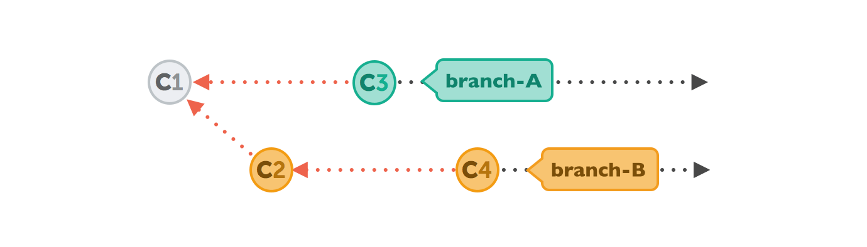
Git rebase
git-rebase - Reapply commits on top of another base tip.

Slide 11
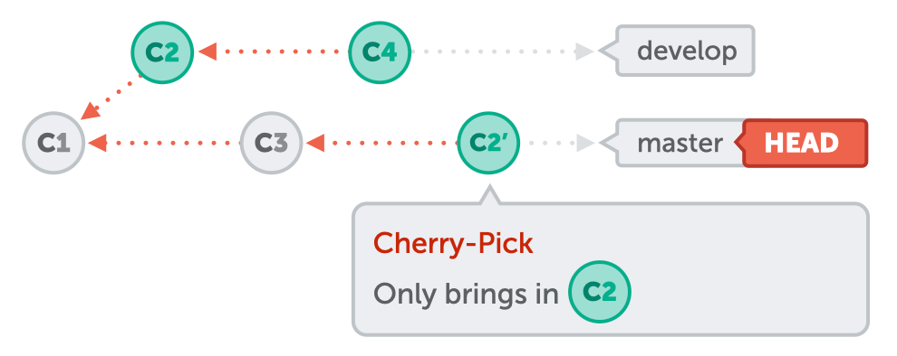
Git cherry-pick
git-cherry-pick - Apply the changes introduced by some existing commits.

Slide 12


